Slide 1
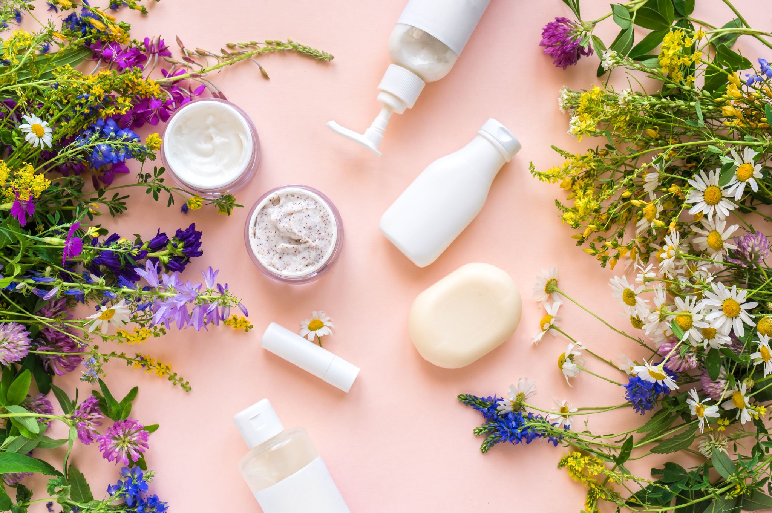
COSMETICS RECOMMENDATION
Team 8:
Shrisha
Soham
Srikanth
Harshini

Slide 2
Introduction
Consumers usually depend on recommended products from sellers i.e best selling products but these days one cannot blindly do this.
We know the information we need is on the back of each product, but it’s really hard to interpret those ingredient lists unless you’re a chemist.
So we decided to create a cosmetic recommendation system.

Slide 3

System Design
Web Scrapping
Data Preprocessing
Data Analysis
Modelling
Visualization

Slide 4
Web Scrapping
As a first step, we would like to web scrap from Sephora. To focus on the skin care items, the dataset contains six different categories. We are aiming at restricting the dataset around 1500 items.
For each item brand, price, rank(rating), skin types and ingredients are included.

Slide 5
Categories:
moisturizing cream
facial treatments
cleanser
facial mask
eye treatment
sun protection

Slide 6
Data preprocessing
Clean_data: Dropped the URL column and updated the category names to make it compact
Process-ingredients: Dropped newlines or indentations and removed the non ingredient text(Ex: please, no info etc)
skin_type_preprocessing: Skin type is a categorical data and it is converted to One-Hot encoded vector
Preprocess_price: Price containing dollar string is converted to numerical data
Preprocess_rank: Converting the rating in string format to numerical data

Slide 7
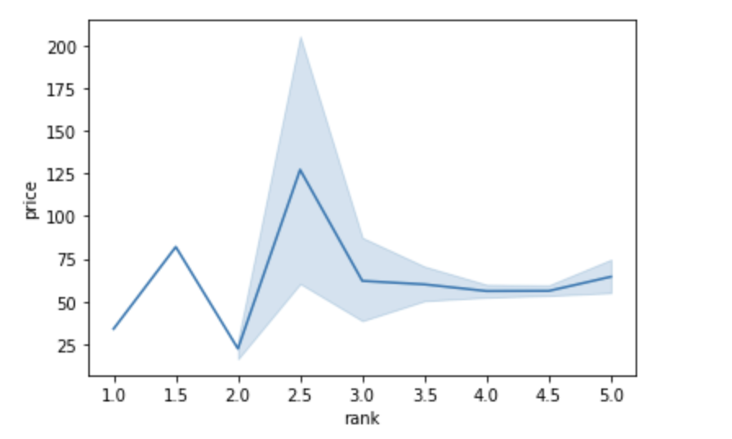
Data Analysis
The graph depicts that higher price of the product does not imply better rank or rating.
Variability in rating of products is high from rank 2 to 3.

Slide 8
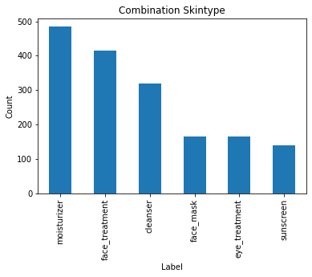
Data Analysis
For the combination skintype:
There are around 500 users who are using moisturizer and around 150 users using sunscreen.

Slide 9
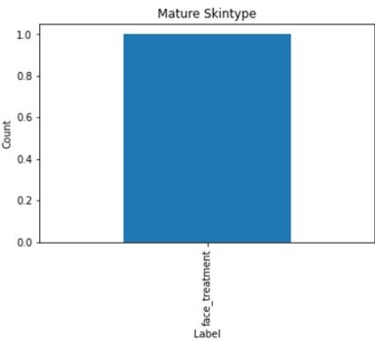
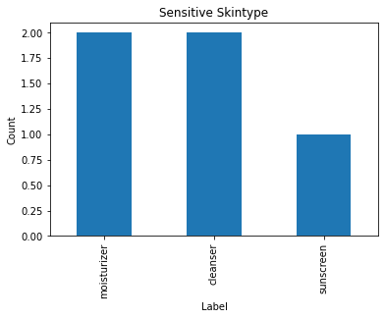
Data Analysis
From the plots we see that for Mature skin type we do not have only face_treatment category product and for Sensitive skin we have only moisturizer, cleanser and sunscreen and missing other 3 category types
This may result in errors later while modelling so we decided to drop these skin types

Slide 10
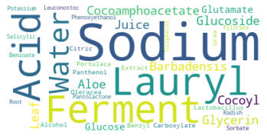
NLP: Wordclouds
Wordcloud for cleanser: This depicts that cleanser mainly contains Sodium, lauryl, Acid, water and ferment as their main ingredients.

Slide 11
Modelling
Generating tokens: Splitting the complete chemical composition based on space so that tokens are generated and makes the dictionary where each ingredient is key and the count(unique for each ingredient)is value.
Encoder: Creating the binary equivalent using ingredients for each product.
t-SNE: Create document term matrix and perform t-SNE for dimensionality reduction

Slide 12
Recommendations Implemented
Content-based Recommendation
TF-IDF based Recommendation

Slide 13
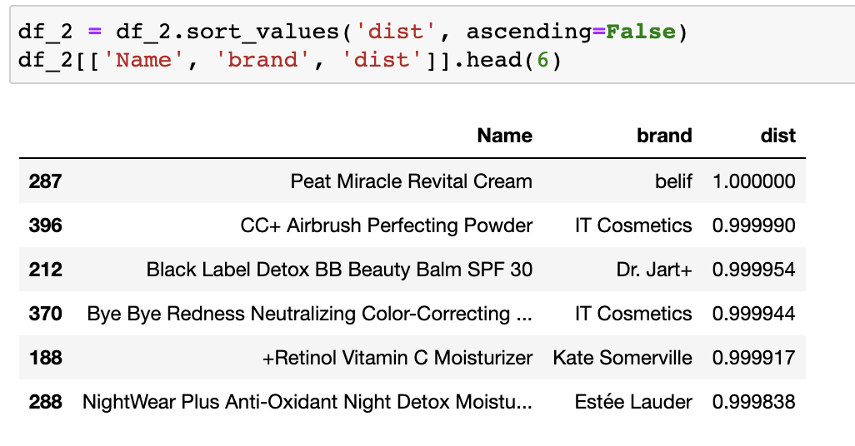
Content-based recommendation
Based on the t_SNE dimensionality reduction find cosine similarity of all items with the given item
Sorted the products based on the decreasing order of distance
Pick the top 5 products

Slide 14
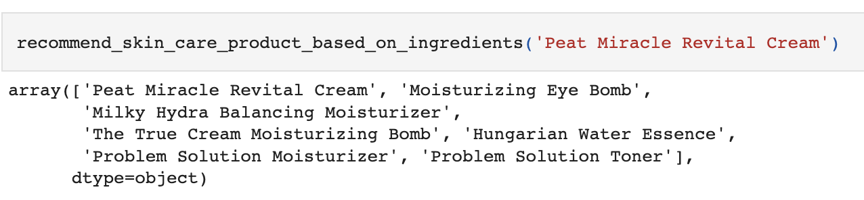
TF-IDF Recommendation
Similarity matrix is generated using linear kernel
For a given input of product we compare with all other products get similarity score
Sort the similarity scores for each product and select the top 5

Slide 15
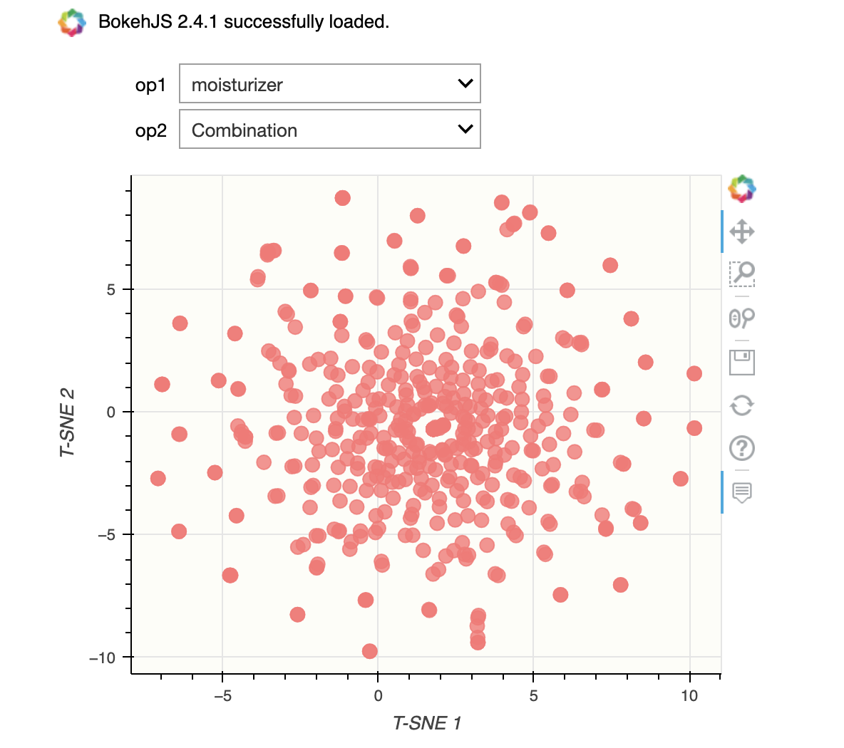
Visualization
Bokeh plot of users with combination skin and using moisturizer.
Bokeh was used because it can produce interactive plots

Slide 16
Final-outcome
Content based recommendation and TF-IDF based recommendation was implemented
By manually comparing the ingredients from Content based recommendation and TFIDF based recommendation and we found that TFIDF based recommendation was slightly better
If we have any survey mentioning the users liking, then we can quantify the evaluation of each of the recommendation system

Slide 17

Thank you!!

